Slide 1
Feistel-Based Cryptographic Algorithm
Md Nahid Hasan
Phanidhar Akula
Robert Kilgore
Sudhir Yadav

Slide 2
Introduction
The algorithm includes
A 32-bit key
An LFSR-based key schedule
S-Box Transformation for non-linearity
Bit-level permutation for diffusion
A Feistel-like structure for encryption and decryption

Slide 3
Key Length and Scheduling
Key Length
The algorithm uses a 32-bit key which allows 2³² (approximately 4.29 billion) possible unique keys
This master key is used to seed the key expansion mechanism that generates round subkeys for both encryption and decryption.
Key Scheduling
The 32‑bit master key serves as the seed for a LFSR
The LFSR produces a random sequence from which, for every round, the lower 16 bits are extracted as the subkey
The LFSR polynomial taps are at positions [0, 1, 21, 31]

Slide 4
S-Box Transformation (Substitution)
Introduces non-linearity to resist linear and differential attacks
An 4×4 S-Box maps 4-bit inputs to 4-bit outputs.
Each 16-bit half of the block is divided into four 4-bit nibbles, and each nibble is substituted using the S-Box.
Randomly generated S-Box values (key-dependent) increase security by making the substitution layer dynamic.
Bit-Level Permutations
Each round applies a fixed bit permutation (P-box) to the 16-bit halves.
Example : Each bit at position i is moved to position (3 × i) mod 16
This improves diffusion by ensuring that a small change in the input spreads across multiple bits in subsequent rounds.

Slide 5
Encryption Algorithm
Overview
Split 32-bit block into two 16-bit halves (L, R)
For each round, generate a unique 16‑bit subkey from the 32‑bit master key using an LFSR
Apply N rounds of
- S-Box transformation on L
- Permutation P on the S-Box output
- XOR result with subkey
- Swap L and R
Combine L and R into a 32-bit ciphertext

Slide 6
Encryption Algorithm
Pseudocode
function Encrypt_Block(plaintext_32, KEY_32, N):
(L, R) ← split_into_16_bit_halves(plaintext_32)
Subkeys ← KeySchedule_Expand(KEY_32)
for i from 1 to N:
F = P_BOX( S_BOX(R) ) XOR Subkeys[i]
new_L = R
new_R = L XOR F
(L, R) = (new_L, new_R)
return combine_halves(L, R)

Slide 7
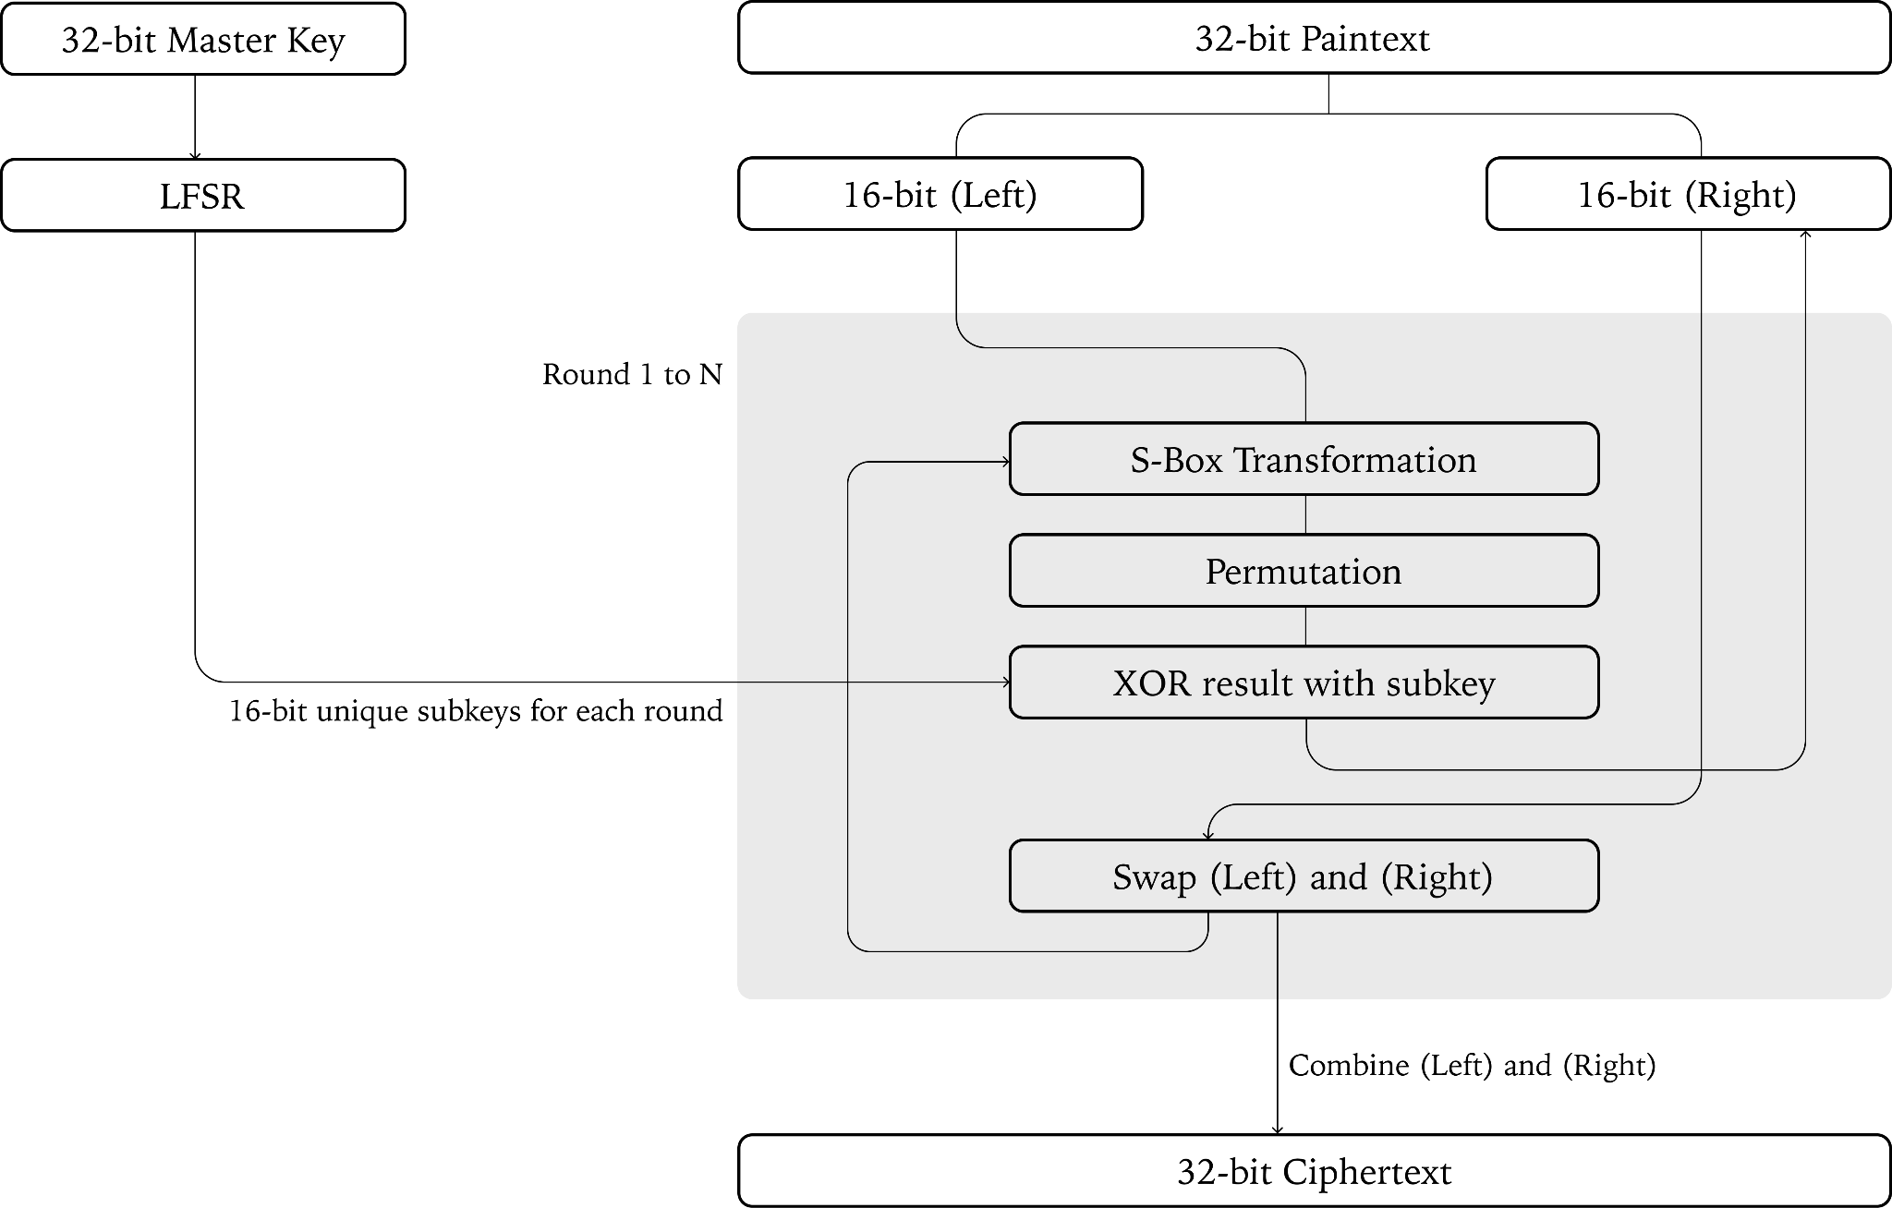
Flow Chart

Slide 8
Decryption Algorithm
Overview
Decryption follows the Feistel structure, reversing the encryption steps
The same subkeys are used but in reverse order
The inverse of the S-Box and permutation function (P-Box) is applied to undo the substitutions and bit shuffling.
This ensures lossless recovery of plaintext from ciphertext

Slide 9
Decryption Algorithm
Pseudocode
function Decrypt_Block(ciphertext_32, KEY_32, N):
(L, R) ← split_into_16_bit_halves(ciphertext_32)
Subkeys ← KeySchedule_Expand(KEY_32)
for i from N down to 1:
F = P_BOX( S_BOX(L) ) XOR Subkeys[i]
new_R = L
new_L = R XOR F
(L, R) = (new_L, new_R)
return combine_halves(L, R)

Slide 10
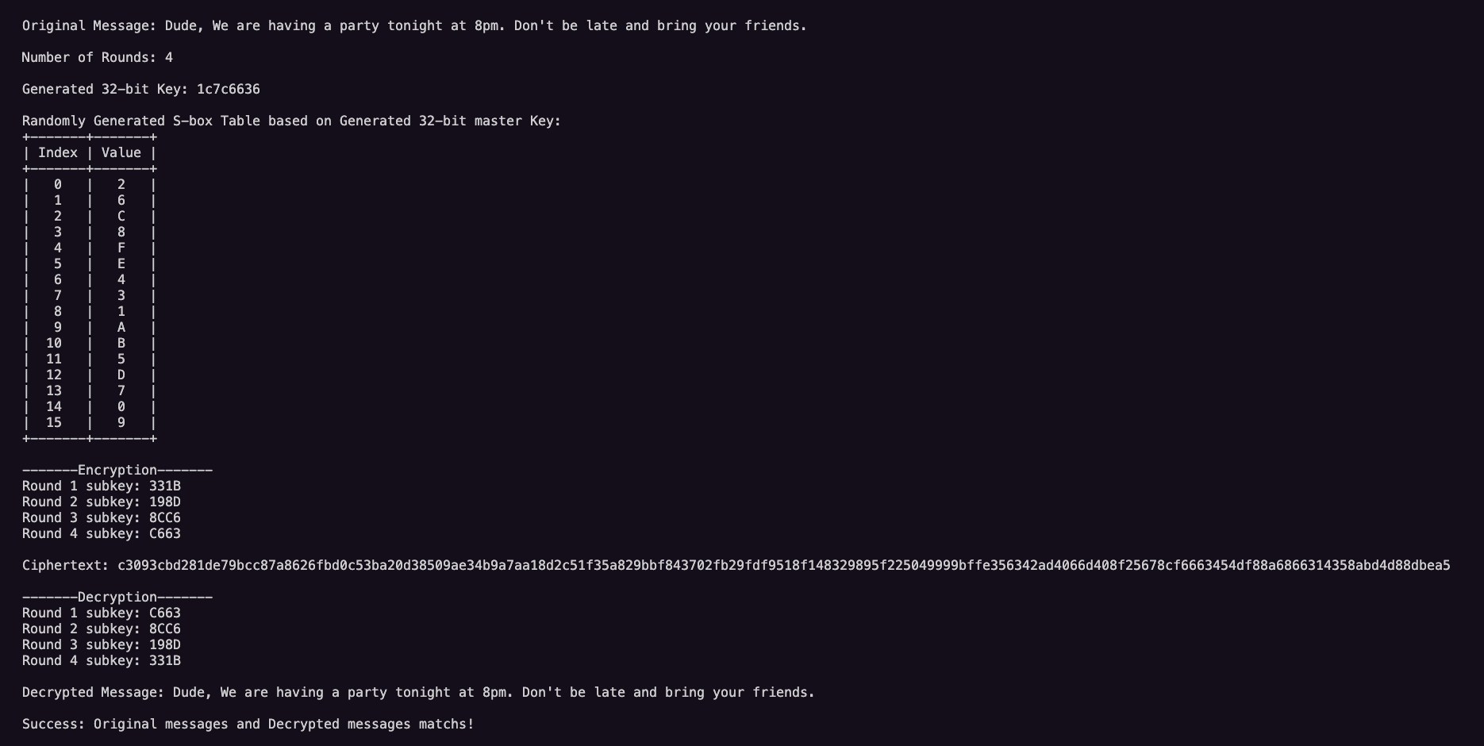
Working Example

Slide 11
Conclusion
This is a custom cryptographic algorithm which uses various core components
While a 32-bit key is not strong for real-world use, but this design is very fast and has solid structure
Future improvements: Increase key size, use stronger S-Boxes, and more complex permutations

